Slide 1

Real Time Identity Ribbon Detection Based on Histogram Oriented Gradient and Linear Supported Vector Machine
Presented by
Supervised by
Tamim Hasan
Id:181-35-2432
Dept of swe,diu
Kaushik sarker
Assistant professor and associate head
Dept of swe ,diu

Slide 2
O U T L I N E
PLAN
PLAN
PLAN
PLAN
PLAN
PLAN
BACKGROUND
MOTIVATION
Literature Review
SCOPE
METHODOLOGY
IMPLEMENTATIN
1
2
3
4
5
6
Background behind topic
Motivation
behind topic
Literature
about topic
My work scope
Methodology
use topic
Model implementatio

Slide 3
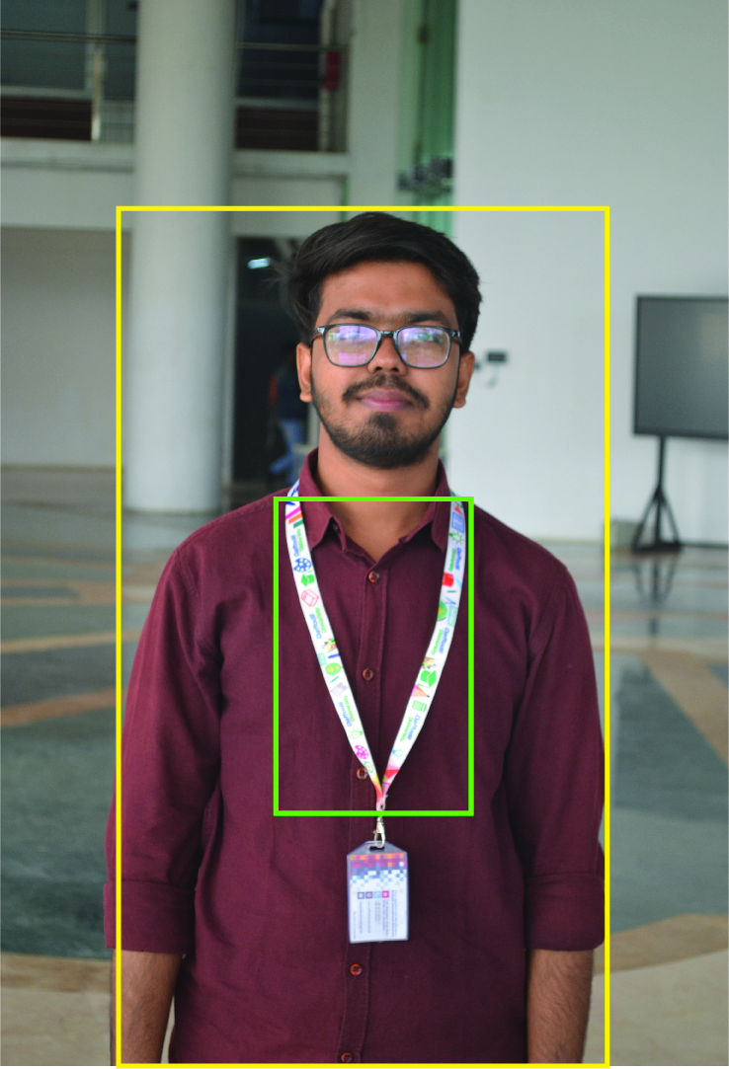
Background
PLAN
1
In recent years, there has been a significant increase in research interest supporting the development of the object detection, which is an AI platform capable of sensing and reacting to it’s immediate environment in an attempt to navigate roadways without human intervention. Object detection is a computer vision technique that works to identify and locate objects within an image or video. I propose a novel attention-based convolutional neural network which regulates multiple object parts among different input images. Ribbon detection and characterization, is a key procedure in many nephropathologist studies. In this thesis, semantic segmentation based on convolutional neural networks is proposed to detect RIBBON.

Slide 4

Motivation
PLAN
2
01
Want to analyze the previous year's research HOG and
Linear SVM for object detection in related topic.
02
Predict the Object based on these features by using deep learning approach.
03
Provide some favorable suggestions regarding this issue.
Hopefully, this research would be helpful for the all kind of stakeholders related to the Object recognition issue.

Slide 5
PLAN
Literature Review
3
NO | Author | Paper | Method | Year | Finding Lacking’s
1 | Nikola Tomikj Andrea Kulakov | Identity card with HOG and Linear SVM | HOG and Linear SVM. | 2021 | 64×64 pixels
2 | Sai Krishna Chadalawada | Real Time Object Detection and Recognition Using Deep Learning Methods | Fast R-CNN. Faster R-CNN. | 2020 | Average Recognition Rate is: 76.43%
3 | Kaiming He, Xiangyu Zhang, Shaoqing Ren, Jian Sun | Deep Residual Learning for Image Recognition | Residual Networks (ResNet) | 2016 | The training error ResNet is: 80%
4 | Jianlong Fu, Heliang Zheng, Tao Mei | Look Closer to See Better: Recurrent Attention Convolutional Neural Network for Image Recognition | Recurrent Attention Convolutional Neural Network (RA-CNN) | 2017 | Overall accuracy in RA-CNN: 82.5%
5 | Prem Kumar Bhaskar Suet-Peng Yong | Image Processing Based ID card detection and Tracking Method | YOLO Faster R-CNN OpenCV | 2014 | Low Accuracy in CNN: 86.5%

Slide 6
PLAN
Literature Review
3
NO | Author | Paper | Method | Year | Finding Lacking’s
6 | Zhong-Qiu Zhao Peng Zheng, Shou-Tao Xu, and Xindong W | Object Detection With Deep Learning: A Review | Region-based Convolutional Neural Networks (R-CNN) | 2019 | It achieves 85.14% accuracy
7 | Chieh-Ling, Huang Heng-Ning, Ma | A Moving Object Detection Algorithm for identity card detection. | Object Detection Algorithm Faster R-CNN | 2015 | The experiment is repeated more than 5 times to produce an average result
8 | Jian Gong Fuqiang Liu Chunlin Song | Moving object detection Algorithm Based on the Motion Vector | Faster R-CNN Fast R-CNN Optical Flow Method architecture method used in this paper | 2020 | Overall accuracy found: 68.3%
9 | Jianlong Fu, Heliang Zheng, Tao Mei | A Large-Scale Car Dataset for image Categorization and Verification | Recurrent Attention Convolutional Neural Network (RA-CNN) | 2015 | Accuracy level not found
10 | Xuewen Chen, Huaqing Chen, and Huan Xu | Identity card Based on Multifeatured Extraction and Recognition Adopting RBF Neural Network on ADAS System | Multifeatured Extraction and Recognition Adopting RBF Neural Network on ADAS System | 2020 | Low Accuracy found in CNN: 76.6%

Slide 7

PLAN
Scope
4
1
Scope1
Dual priorities: object classification and localization. The first major complication of object detection is its added goal.
Scope2
2
Different level attentions focus on different characteristics of the image, which are complementary and boost the classification accuracy.
3
Scope3
The user can easily track diu members on different background images.
It can play very important role in identifying diu students, and teachers.
Scope4
4

Slide 8
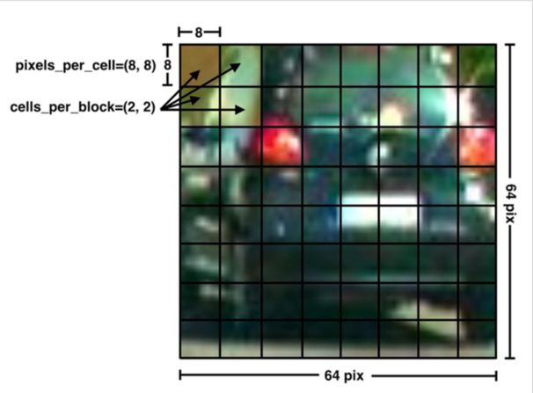
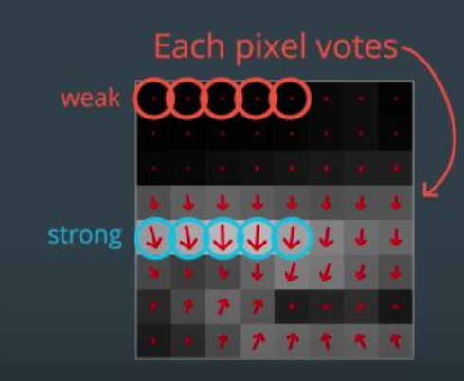
PLAN
5
Methodology
In this section, I present my proposed method which can efficiently and accurately attend discriminative regions despite being trained only on image level labels. As shown in 2 image.
the framework of our method is composed by two parts:
Histogram of Oriented Gradients (HOG)
Support-Vector Machines(SVM)

Slide 9
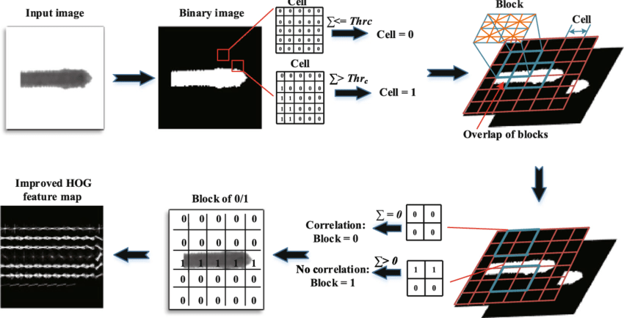
Methodology
PLAN
5
Histogram of oriented gradients (HOG)
HOG, or Histogram of Oriented Gradients, is a feature descriptor that is often used to extract features from image data. It is widely used in computer vision tasks for object detection.
Preprocess the Data (64 x 128)
Calculating Gradients (direction x and y)
Calculate the Magnitude and Orientation
Different Methods to Create Histograms using
Gradients and Orientation
Calculate Histogram of Gradients in 8×8 cells (9×1)
Normalize gradients in 16×16 cell (36×1)
Features for the complete image
Implementing HOG Feature

Slide 10
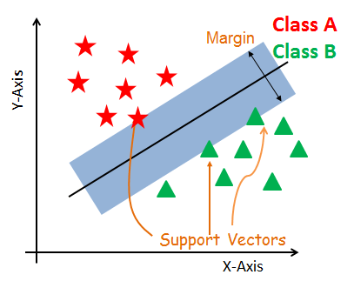
Methodology
PLAN
5
Support Vector Machine(SVM)
SVM or Support Vector Machine is a linear model for classification and regression problems. It can solve linear and non-linear problems and work well for many practical problems.
The idea of SVM is simple: The algorithm creates a line or a hyperplane which separates the data into classes.
Import the dataset
Explore the data to figure out what they look like
Pre-process the data
Split the data into attributes and labels
Divide the data into training and testing sets
Train the SVM algorithm
Make some predictions
Evaluate the results of the algorithm

Slide 11
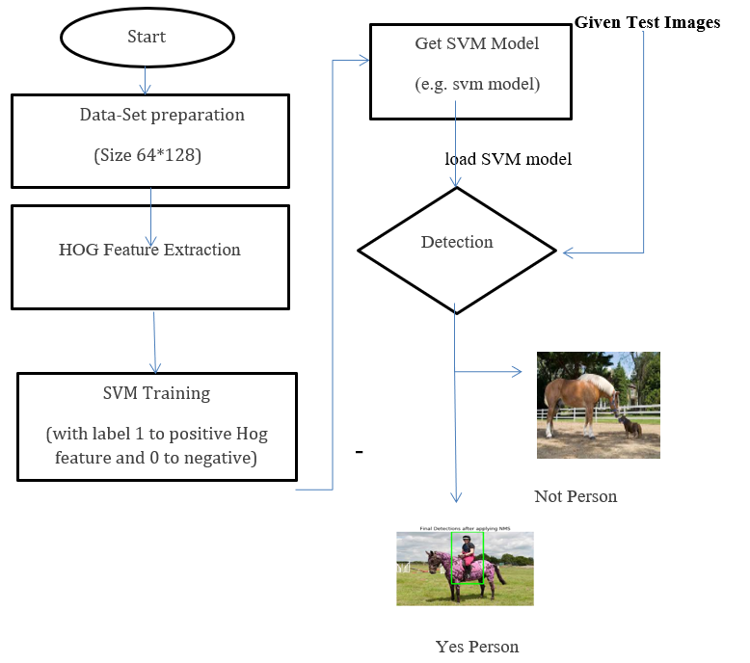
PLAN
Methodology
5
Full Process for Object Detection Using HOG and SVM
Performed a Histogram of Oriented Gradients (HOG) feature extraction on a labeled training set of images.
Trained a classifier with the set of ribbon and ribbon images.
Implemented a sliding window to get subregions of a single video frame.
Used my trained classifier to detect ribbon on subregions.
Created a heat map of recurring detections frame by frame to follow and detect ribbon.

Slide 12
PLAN
Implementation
6
Test | Result | Accuracy
Student1.jpg | Match | 100%
Student2.jpg | Match | 100%
Student3.jpg | Match | 100%
Teacher1.jpg | Match | 100%
Teacher2.jpg | Match | 100%
Teacher3.jpg | Match | 100%

Slide 13
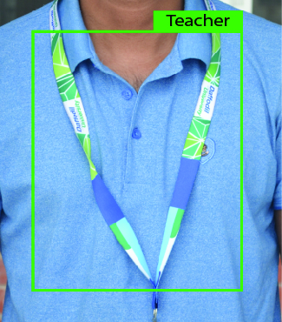
PLAN
Implementation
6
Output of Teacher.jpg picture

Slide 14
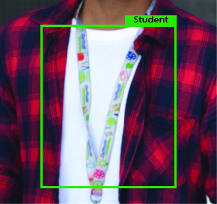
PLAN
Implementation
6
Output of Student.jpg Picture

Slide 15

T H A N K
Y O U

